Slide 1

MACHINE INTELLIGENCE
Dr. N MEHALA
Department of Computer Science and Engineering

Slide 2

MACHINE INTELLIGENCE
Module 4 [Unsupervised Learning]
Dr. N MEHALA
Department of Computer Science and Engineering

Slide 3
MACHINE INTELLIGENCE
FP GROWTH ALGORITHM

Slide 4
MACHINE INTELLIGENCE
Apriori VS FP GROWTH ALGORITHM
Apriori: uses a generate-and-test approach- generates candidate itemsets and tests if they are frequent
Generation of candidate itemsets is expensive (in terms of both space and time)
Support counting is expensive
Subset checking (computationally expensive)
Multiple Database scans (I/O)

Slide 5
MACHINE INTELLIGENCE
FP Growth Algorithm
Use a compressed representation of the database using an FP-tree
FP-Growth: allows frequent item set discovery without candidate item set generation
Two step approach:
Step 1: Build a compact data structure called the FP-tree
- Built using 2 passes over the data-set.
Step 2: Extracts frequent item sets directly from the FP-tree
- Traversal through FP-Tree
Once an FP-tree has been constructed, it uses a recursive divide-and-conquer approach to mine the frequent item sets

Slide 6
MACHINE INTELLIGENCE
FP Growth Algorithm : Example

Slide 7
First scan – determine frequent 1-itemsets, then build header
MACHINE INTELLIGENCE
FP Growth Algorithm : Example
B | 8
A | 7
C | 7
D | 5
E | 3

Slide 8
FP-tree construction
MACHINE INTELLIGENCE
FP Growth Algorithm : Example
null
After reading TID=1:
B:1
A:1
After reading TID=2:
null
B:2
C:1
A:1
D:1

Slide 9
FP-Tree Construction
MACHINE INTELLIGENCE
FP Growth Algorithm : Example
Transaction Database
null
B:8
A:2
A:5
C:3
C:1
D:1
C:3
D:1
D:1
E:1
D:1
E:1
Header table
D:1
E:1
Chain pointers help in quickly finding all the paths of the tree containing some given item.

Slide 10
MACHINE INTELLIGENCE
FP Growth Algorithm : Example
null
null
B:1
A:2
B:8
A:2
C:1
C:1
D:1
A:5
C:3
C:1
D:1
E:1
D:1
E:1
C:3
D:1
D:1
E:1
D:1
E:1
E:1
D:1
E:1
Paths containing node E

Slide 11
Conditional FP-Tree for E
MACHINE INTELLIGENCE
FP Growth Algorithm : Example
FP-Growth builds a conditional FP-Tree for E, which is the tree of itemsets ending in E.
It is not the tree obtained in previous slide as result of deleting nodes from the original tree.
Because the order of the items can change.
Now, C has a higher count than B.

Slide 12
Suffix E
MACHINE INTELLIGENCE
FP Growth Algorithm : Example
null
(New) Header table
B:1
A:2
A | 2
C | 2
D | 2
Conditional FP-Tree for suffix E
C:1
C:1
D:1
null
E:1
D:1
E:1
B doesn’t survive because it has support 1, which is lower than min support of 2.
C:1
A:2
E:1
C:1
D:1
The set of paths ending in E.
Insert each path (after truncating E) into a new tree.
D:1
We continue recursively.
Base of recursion: When the tree has a single path only.
FI: E

Slide 13
Steps of Building Conditional FP-Trees
MACHINE INTELLIGENCE
FP Growth Algorithm : Example
Find the paths containing on focus item.
Read the tree to determine the new counts of the items along those paths.
Build a new header.
Read again the tree. Insert the paths in the conditional FP-Tree according to the new order.

Slide 14
Suffix DE
MACHINE INTELLIGENCE
FP Growth Algorithm : Example
(New) Header table
Conditional FP-Tree for suffix E
A | 2
null
The conditional FP-Tree for suffix DE
null
A:2
C:1
A:2
C:1
D:1
null
C:1
D:1
D:1
A:2
D:1
The set of paths, from the E-conditional FP-Tree, ending in D.
Insert each path (after truncating D) into a new tree.
We have reached the base of recursion.
FI: DE, ADE

Slide 15
Base of Recursion
MACHINE INTELLIGENCE
FP Growth Algorithm : Example
We continue recursively on the conditional FP-Tree.
Base case of recursion: when the tree is just a single path.
Then, we just produce all the subsets of the items on this path merged with the corresponding suffix.

Slide 16
Suffix CE
MACHINE INTELLIGENCE
FP Growth Algorithm : Example
(New) Header table
Conditional FP-Tree for suffix E
null
null
The conditional FP-Tree for suffix CE
C:1
A:1
C:1
A:2
C:1
C:1
D:1
null
D:1
The set of paths, from the E-conditional FP-Tree, ending in C.
Insert each path (after truncating C) into a new tree.
We have reached the base of recursion.
FI: CE

Slide 17
MACHINE INTELLIGENCE
FP Growth Algorithm : Example
(New) Header table
Conditional FP-Tree for suffix E
Suffix AE
null
The conditional FP-Tree for suffix AE
C:1
A:2
null
null
A:2
C:1
D:1
D:1
The set of paths, from the E-conditional FP-Tree, ending in A.
Insert each path (after truncating A) into a new tree.
We have reached the base of recursion.
FI: AE

Slide 18
MACHINE INTELLIGENCE
FP Growth Algorithm : Example
Suffix D
null
(New) Header table
B:3
A:2
A | 4
B | 3
C | 3
Conditional FP-Tree for suffix D
A:2
C:1
C:1
D:1
null
C:1
D:1
D:1
D:1
B:3
A:2
D:1
A:2
C:1
C:1
The set of paths ending in D.
Insert each path (after truncating D) into a new tree.
C:1
We continue recursively.
Base of recursion: When the tree has a single path only.
FI: D

Slide 19
MACHINE INTELLIGENCE
Suffix CD
FP Growth Algorithm : Example
(New) Header table
Conditional FP-Tree for suffix D
A | 2
B | 2
null
Conditional FP-Tree for suffix CD
B:3
A:2
A:2
null
C:1
C:1
C:1
B:3
A:2
The set of paths, from
the D-conditional FP-Tree, ending in C.
Insert each path (after truncating C) into a new tree.
A:2
We continue recursively.
Base of recursion: When the tree has a single path only.
FI: CD

Slide 20
MACHINE INTELLIGENCE
Suffix BCD
FP Growth Algorithm : Example
(New) Header table
Conditional FP-Tree for suffix BCD
null
null
B:3
A:2
A:2
The set of paths from
the CD-conditional FP-Tree, ending in B.
Insert each path (after truncating B) into a new tree.
We have reached the base of recursion.
FI: BCD

Slide 21
MACHINE INTELLIGENCE
FP Growth Algorithm : Example
(New) Header table
null
Conditional FP-Tree for suffix ACD
null
null
Suffix ACD
B:3
A:2
A:2
The set of paths from
the CD-conditional FP-Tree, ending in A.
Insert each path (after truncating B) into a new tree.
We have reached the base of recursion.
FI: ACD

Slide 22
Suffix C
MACHINE INTELLIGENCE
FP Growth Algorithm : Example
null
(New) Header table
Conditional FP-Tree for suffix C
B:6
A:1
B | 6
A | 4
A:3
C:3
C:1
null
C:3
B:6
A:1
A:3
The set of paths ending in C.
Insert each path (after truncating C) into a new tree.
We continue recursively.
Base of recursion: When the tree has a single path only.
FI: C

Slide 23
Suffix AC
MACHINE INTELLIGENCE
FP Growth Algorithm : Example
null
(New) Header table
B | 3
Conditional FP-Tree for suffix AC
B:6
A:1
A:3
null
B:3
The set of paths from
the C-conditional FP-Tree, ending in A.
Insert each path (after truncating A) into a new tree.
We have reached the base of recursion.
FI: AC, BAC

Slide 24
Suffix BC
MACHINE INTELLIGENCE
FP Growth Algorithm : Example
null
(New) Header table
Conditional FP-Tree for suffix BC
B | 3
B:6
null
The set of paths from
the C-conditional FP-Tree, ending in B.
Insert each path (after truncating B) into a new tree.
We have reached the base of recursion.
FI: BC

Slide 25
Suffix A
MACHINE INTELLIGENCE
FP Growth Algorithm : Example
null
(New) Header table
Conditional FP-Tree for suffix A
B:5
A:2
B | 5
A:5
null
B:5
The set of paths ending in A.
Insert each path (after truncating A) into a new tree.
We have reached the base of recursion.
FI: A, BA

Slide 26
Suffix B
MACHINE INTELLIGENCE
FP Growth Algorithm : Example
(New) Header table
Conditional FP-Tree for suffix B
null
null
B:8
We have reached the base of recursion.
FI: B
The set of paths ending in B.
Insert each path (after truncating B) into a new tree.

Slide 27
FREQUENT ITEM SETS:
MACHINE INTELLIGENCE
FP Growth Algorithm : Example
FI: E, DE, ADE
FI: CE
FI: AE
FI: D, CD
FI: BCD
FI: ACD
FI: C
FI: AC, BAC
FI: B
FI: BC
FI: A, BA

Slide 28
Array Technique
MACHINE INTELLIGENCE
FP Growth Algorithm : Example

Slide 29
FP-Tree Construction
MACHINE INTELLIGENCE
FP Growth Algorithm : Example
Transaction Database
Header table
First pass on DB: Determine the header. Then sort it.
Second pass on DB: Build the FP-Tree. Also build an array of counts.
B | 8
A | 7
C | 7
D | 5
E | 3

Slide 30
MACHINE INTELLIGENCE
FP Growth Algorithm : Example
FP-Tree Construction – Reading 1
Transaction Database
null
B:1
A:1
A | 1
C
D
E
 | B | A | C | D
B | 8
A | 7
C | 7
D | 5
E | 3
Header table

Slide 31
MACHINE INTELLIGENCE
FP Growth Algorithm : Example
FP-Tree Construction – Reading 2
Transaction Database
null
B:2
A:1
C:1
D:1
Header table
B | 8
A | 7
C | 7
D | 5
E | 3
A | 1
C | 1
D | 1 |  | 1
E
 | B | A | C | D

Slide 32
MACHINE INTELLIGENCE
FP Growth Algorithm : Example
FP-Tree Construction – Reading 3
Transaction Database
null
B:2
A:1
A:1
C:1
C:1
D:1
D:1
B | 8
A | 7
C | 7
D | 5
E | 3
A | 1
C | 1 | 1
D | 1 | 1 | 2
E |  | 1 | 1 | 1
 | B | A | C | D
E:1
Header table

Slide 33
MACHINE INTELLIGENCE
FP Growth Algorithm : Example
FP-Tree Construction – Reading 4
Transaction Database
null
B:2
A:2
A:1
C:1
C:1
D:1
D:1
D:1
E:1
B | 8
A | 7
C | 7
D | 5
E | 3
Header table
A | 1
C | 1 | 1
D | 1 | 2 | 2
E |  | 2 | 1 | 2
 | B | A | C | D
E:1

Slide 34
MACHINE INTELLIGENCE
FP Growth Algorithm : Example
FP-Tree Construction – Reading 5
Transaction Database
null
B:3
A:2
A:2
C:1
C:1
D:1
C:1
D:1
D:1
E:1
B | 8
A | 7
C | 7
D | 5
E | 3
E:1
Header table
A | 2
C | 2 | 2
D | 1 | 2 | 2
E |  | 2 | 1 | 2
 | B | A | C | D

Slide 35
MACHINE INTELLIGENCE
FP Growth Algorithm : Example
FP-Tree Construction – Reading 6
null
Transaction Database
B:4
A:2
A:3
C:1
C:1
D:1
C:2
D:1
D:1
E:1
D:1
E:1
B | 8
A | 7
C | 7
D | 5
E | 3
A | 3
C | 3 | 3
D | 2 | 3 | 3
E |  | 2 | 1 | 2
 | B | A | C | D
Header table

Slide 36
MACHINE INTELLIGENCE
FP Growth Algorithm : Example
FP-Tree Construction – Reading 7
null
Transaction Database
B:5
A:2
A:3
C:2
C:1
D:1
C:2
D:1
D:1
E:1
D:1
E:1
Header table
B | 8
A | 7
C | 7
D | 5
E | 3
A | 3
C | 4 | 3
D | 2 | 3 | 3
E |  | 2 | 1 | 2
 | B | A | C | D

Slide 37
MACHINE INTELLIGENCE
FP Growth Algorithm : Example
FP-Tree Construction – Reading 8
null
Transaction Database
B:6
A:2
A:4
C:2
C:1
D:1
C:3
D:1
D:1
E:1
D:1
E:1
B | 8
A | 7
C | 7
D | 5
E | 3
Header table
A | 4
C | 5 | 4
D | 2 | 3 | 3
E |  | 2 | 1 | 2
 | B | A | C | D

Slide 38
MACHINE INTELLIGENCE
FP Growth Algorithm : Example
FP-Tree Construction – Reading 9
null
Transaction Database
B:7
A:2
A:5
C:2
C:1
D:1
C:3
D:1
D:1
D:1
E:1
D:1
E:1
Header table
B | 8
A | 7
C | 7
D | 5
E | 3
A | 5
C | 5 | 4
D | 3 | 4 | 3
E |  | 2 | 1 | 2
 | B | A | C | D

Slide 39
MACHINE INTELLIGENCE
FP Growth Algorithm : Example
FP-Tree Construction – Reading 10
null
Transaction Database
B:8
A:2
A:5
C:3
C:1
D:1
C:3
D:1
D:1
E:1
D:1
E:1
D:1
E:1
B | 8
A | 7
C | 7
D | 5
E | 3
A | 5
C | 6 | 4
D | 3 | 4 | 3
E | 1 | 2 | 2 | 2
 | B | A | C | D
Header table

Slide 40
Why have the array?
MACHINE INTELLIGENCE
FP Growth Algorithm : Example
Constructing conditional FP-Trees.
Without array
Traverse the base FP-Tree to determine the new item counts.
Construct a new header.
Traverse again the base FP-Tree and construct the conditional FP-Tree.
With array
Construct a new header helped by the array.
Traverse the base FP-Tree and construct the conditional FP-Tree.
Saving
One tree traversal.
Important because experimentally it’s shown that 80% of time is spent on tree traversals.

Slide 41
Suffix E
MACHINE INTELLIGENCE
FP Growth Algorithm : Example
null
(New) Header table
B:8
A:2
A | 2
C | 2
D | 2
A | 5
C | 6 | 4
D | 3 | 4 | 3
E | 1 | 2 | 2 | 2
 | B | A | C | D
C:3
C:1
D:1
E:1
D:1
E:1
Conditional FP-Tree for suffix E
E:1
The set of paths ending in E.
Insert each path (after truncating E) into a new tree.
C
D
 | A | C

Slide 42
MACHINE INTELLIGENCE
FP Growth Algorithm : Example
Suffix E (inserting BCE)
null
(New) Header table
B:8
A:2
A | 2
C | 2
D | 2
Conditional FP-Tree for suffix E
C:3
C:1
D:1
null
E:1
D:1
E:1
C:1
E:1
The set of paths ending in E.
Insert each path (after truncating E) into a new tree.
C
D
 | A | C

Slide 43
MACHINE INTELLIGENCE
FP Growth Algorithm : Example
Suffix E (inserting ACDE)
null
(New) Header table
B:8
A:2
A | 2
C | 2
D | 2
Conditional FP-Tree for suffix E
C:3
C:1
D:1
null
E:1
D:1
E:1
C:1
A:1
E:1
The set of paths ending in E.
Insert each path (after truncating E) into a new tree.
C:1
C | 1
D | 1 | 1
 | A | C
D:1

Slide 44
MACHINE INTELLIGENCE
FP Growth Algorithm : Example
Suffix E (inserting ADE)
null
(New) Header table
B:8
A:2
A | 2
C | 2
D | 2
Conditional FP-Tree for suffix E
C:3
C:1
D:1
null
E:1
D:1
E:1
C:1
A:2
E:1
C:1
D:1
The set of paths ending in E.
Insert each path (after truncating E) into a new tree.
C | 1
D | 2 | 1
 | A | C
D:1

Slide 45
MACHINE INTELLIGENCE
Summary

Slide 46
MACHINE INTELLIGENCE
Dr. N MEHALA
Department of Computer Science and Engineering

Slide 47
MACHINE INTELLIGENCE
Module 4 [Unsupervised Learning]
Dr. N MEHALA
Department of Computer Science and Engineering

Slide 48
Similarity and Dissimilarity
More important – used in clustering, some classification, anomaly detection.
Similarity
Numerical measure of how alike two data objects are.
Is higher when objects are more alike.
Often falls in the range [0,1]
Dissimilarity
Numerical measure of how different are two data objects
Lower when objects are more alike
Minimum dissimilarity is often 0
Upper limit varies
Proximity refers to a similarity or dissimilarity

Slide 49
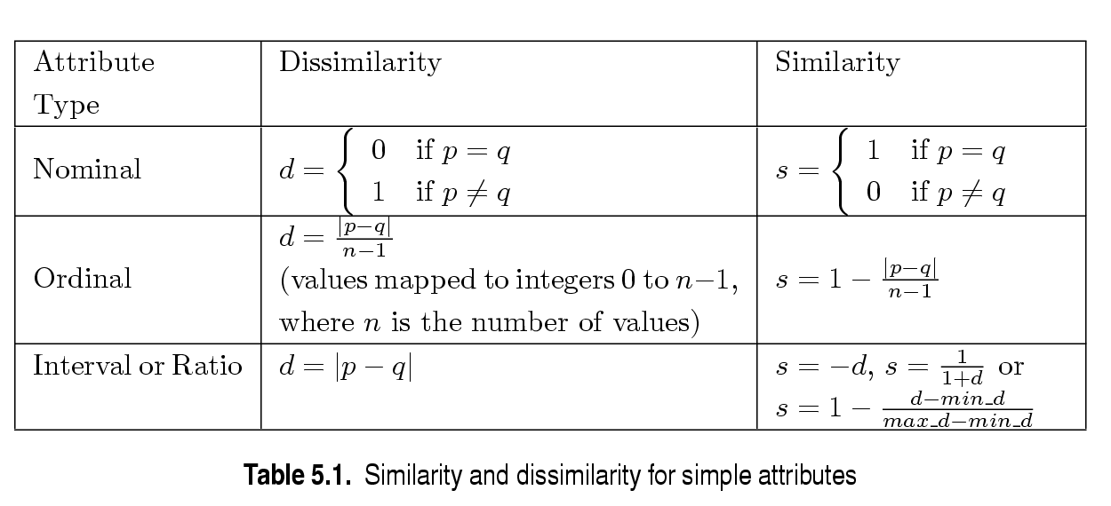
Similarity/Dissimilarity for Objects with Single Attribute
p and q are the attribute values for two data objects.

Slide 50
Dissimilarities between Data Objects with multiple Numeric attributes
For ordinal attributes : Need to normalize the attribute ranks.

Slide 51
Dissimilarities between Data Objects with multiple Numeric attributes
Euclidean Distance
Where n is the number of dimensions and p_{k} and q_{k} are, respectively, the k^{th} attributes of data objects p and q.
Standardization is necessary, if scales differ.

Slide 52
Euclidean Distance
Distance Matrix

Slide 53
Minkowski Distance
Minkowski Distance is a generalization of Euclidean Distance. Given two objects p and q
Where r is a parameter, n is the number of dimensions and p_{k} and q_{k} are, respectively, the kth attributes of data objects p and q.

Slide 54
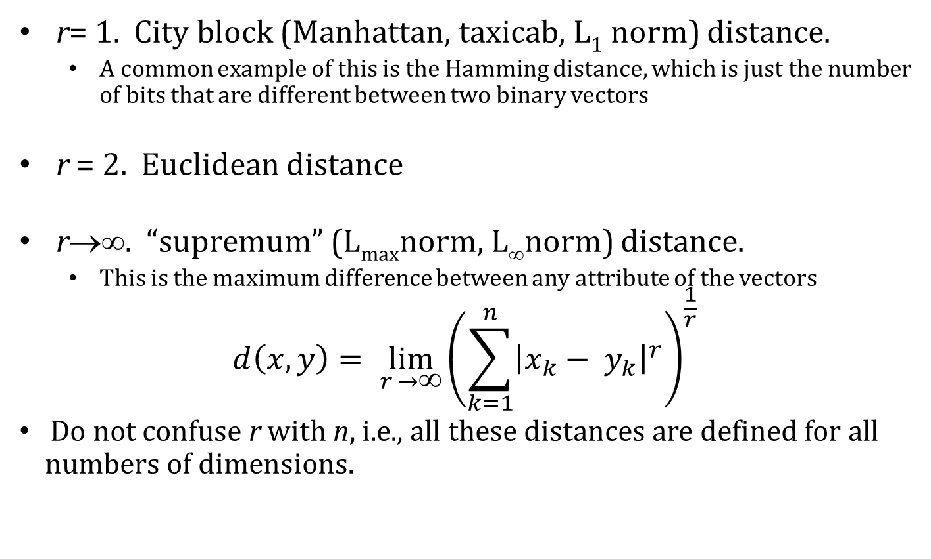
Minkowski Distance: Examples

Slide 55
Minkowski Distance
Distance Matrix

Slide 56
Common Properties of a Distance
Distances, such as the Euclidean distance, have some well known properties.
d(p, q) ≥ 0 for all p and q and d(p, q) = 0 only if p = q. (Positive definiteness)
d(p, q) = d(q, p) for all p and q. (Symmetry)
d(p, r) ≤ d(p, q) + d(q, r) for all points p, q, and r. (Triangle Inequality)
where d(p, q) is the distance (dissimilarity) between points (data objects), p and q.
A distance that satisfies all these properties is a metric

Slide 57
Common Properties of a Similarity
Similarities, also have some well known properties.
s(p, q) = 1 (or maximum similarity) only if p = q.
s(p, q) = s(q, p) for all p and q. (Symmetry)
where s(p, q) is the similarity between points (data objects), p and q.

Slide 58
Similarity Between Binary Vectors
Common situation is that objects, p and q, have only binary attributes
Compute similarities using the following quantities
M₀₁ = the number of attributes where p was 0 and q was 1
M₁₀ = the number of attributes where p was 1 and q was 0
M₀₀ = the number of attributes where p was 0 and q was 0
M₁₁ = the number of attributes where p was 1 and q was 1
Simple Matching and Jaccard Coefficients
SMC = number of matches / number of attributes
= (M₁₁ + M₀₀) / (M₀₁ + M₁₀ + M₁₁ + M₀₀)
J = number of 11 matches / number of not-both-zero attributes values
= (M₁₁) / (M₀₁ + M₁₀ + M₁₁)

Slide 59
SMC versus Jaccard: Example
p = 1 0 0 0 0 0 0 0 0 0
q = 0 0 0 0 0 0 1 0 0 1
M₀₁ = 2 (the number of attributes where p was 0 and q was 1)
M₁₀ = 1 (the number of attributes where p was 1 and q was 0)
M₀₀ = 7 (the number of attributes where p was 0 and q was 0)
M₁₁ = 0 (the number of attributes where p was 1 and q was 1)
SMC = (M₁₁ + M₀₀)/(M₀₁ + M₁₀ + M₁₁ + M₀₀) = (0+7) / (2+1+0+7) = 0.7
J = (M₁₁) / (M₀₁ + M₁₀ + M₁₁) = 0 / (2 + 1 + 0) = 0

Slide 60
SMC & JC
SMC - Counts both presences and absences equally. Used for objects with symmetric binary attributes.
Can be used to find students who answered similarly in a test – true/false questions
JC is used to handle objects with assymetric binary attributes.
Ex: In a TDB:
No. of products not purchased is far more than purchased
SMC would say all transactions are very similar.
Use JC

Slide 61
Cosine Similarity
If d₁ and d₂ are two document vectors, then
cos( d₁, d₂ ) = (d₁ • d₂) / ||d₁|| ||d₂|| ,
where • indicates vector dot product and || d || is the length of vector d.
Example:
d₁ = 3 2 0 5 0 0 0 2 0 0
d₂ = 1 0 0 0 0 0 0 1 0 2
d₁ • d₂= 3*1 + 2*0 + 0*0 + 5*0 + 0*0 + 0*0 + 0*0 + 2*1 + 0*0 + 0*2 = 5
||d₁|| = (3*3+2*2+0*0+5*5+0*0+0*0+0*0+2*2+0*0+0*0)^{0.5} = (42) ^{0.5} = 6.481
||d₂|| = (1*1+0*0+0*0+0*0+0*0+0*0+0*0+1*1+0*0+2*2) ^{0.5} = (6) ^{0.5} = 2.245
cos( d₁, d₂ ) = .3150
Cos(x,y) = 0 indicates both are dissimilar
Cos(x,y) = 1 indicates both are similar

Slide 62
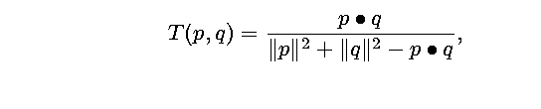
Extended Jaccard Coefficient (Tanimoto)
Variation of JC
Used for document data
Reduces to Jaccard for binary attributes

Slide 63
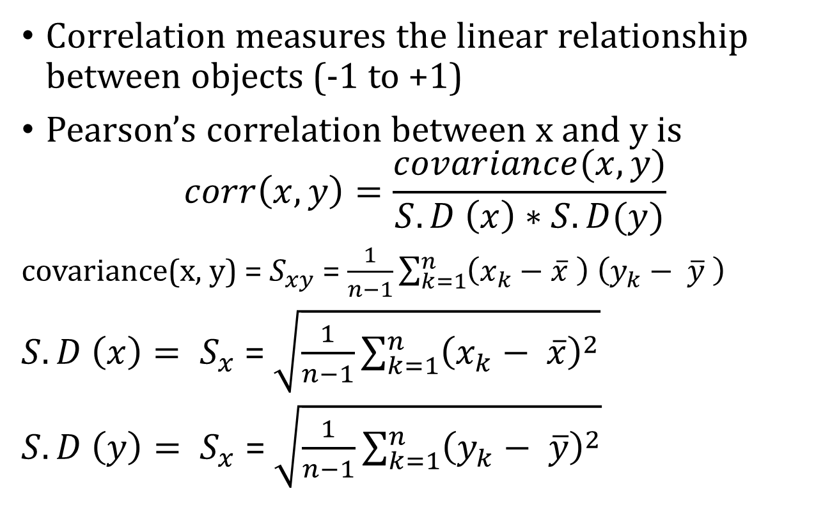
Correlation

Slide 64
Pearson’s Correlation
If correlation between two variables x and y is -1, they are negatively correlated.
If one increases, the other decreases and vice versa.
If correlation between two variables x and y is +1, they are positively correlated.
Either both increase or both decrease.

Slide 65
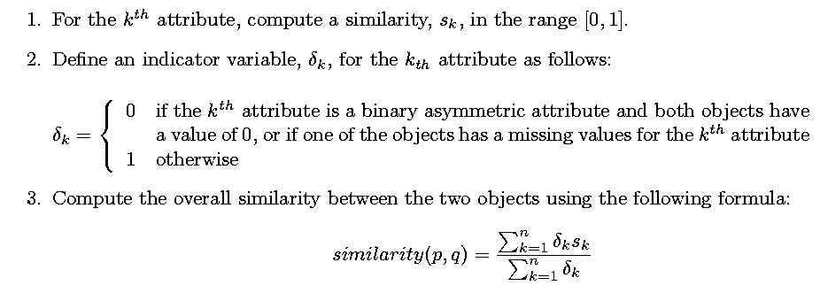
General Approach for Combining Similarities
Sometimes attributes are of many different types, but an overall similarity is needed.

Slide 66
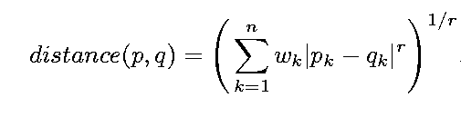

Using Weights to Combine Similarities
May not want to treat all attributes the same.
Use weights w_{k} which are between 0 and 1 and sum to 1

Slide 67
MACHINE INTELLIGENCE
Practice Time

Slide 68
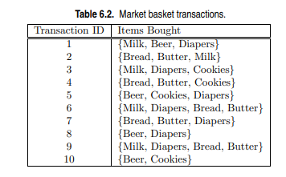
Practice Question 1
(d) Find an itemset (of size 2 or larger) that has the largest support.
(e) Find a pair of items, a and b, such that the rules {a} −→ {b} and {b} −→ {a} have the same confidence
(a) What is the maximum number of association rules that can be extracted from this data (including rules that have zero support)?
(b) What is the maximum size of frequent itemsets that can be extracted (assuming minsup > 0)?
(c) Write an expression for the maximum number of size-3 itemsets that can be derived from this data set.

Slide 69
Practice Question 2
Consider the following set of frequent 3-itemsets: {1, 2, 3}, {1, 2, 4}, {1, 2, 5}, {1, 3, 4}, {1, 3, 5}, {2, 3, 4}, {2, 3, 5}, {3, 4, 5}. Assume that there are only five items in the data set.
(a) List all candidate 4-itemsets obtained by a candidate generation procedure using the Fk−1 × F1 merging strategy.
(b) List all candidate 4-itemsets obtained by the candidate generation procedure in Apriori.
(c) List all candidate 4-itemsets that survive the candidate pruning step of the Apriori algorithm.

Slide 70
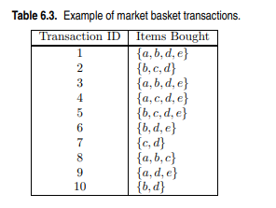
Practice Question 3
Draw an itemset lattice representing the data set given in Table 6.3. Label each node in the lattice with the following letter(s):
• N: If the itemset is not considered to be a candidate itemset by the Apriori algorithm. There are two reasons for an itemset not to be considered as a candidate itemset: (1) it is not generated at all during the candidate generation step, or (2) it is generated during the candidate generation step but is subsequently removed during the candidate pruning step because one of its subsets is found to be infrequent.
• F: If the candidate itemset is found to be frequent by the Apriori algorithm.
• I: If the candidate itemset is found to be infrequent after support counting.
(b) What is the percentage of frequent itemsets (with respect to all itemsets in the lattice)?
(c) What is the pruning ratio of the Apriori algorithm on this data set? (Pruning ratio is defined as the percentage of itemsets not considered to be a candidate because (1) they are not generated during candidate generation or (2) they are pruned during the candidate pruning step.)

Slide 71
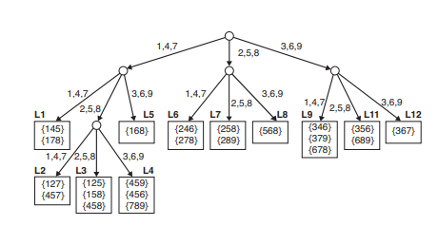
Practice Question 4
The Apriori algorithm uses a hash tree data structure to efficiently count the support of candidate itemsets. Consider the hash tree for candidate 3- itemsets shown in figure below:
Given a transaction that contains items {1, 3, 4, 5, 8}, which of the hash tree leaf nodes will be visited when finding the candidates of the transaction?
(b) Use the visited leaf nodes in part (b) to determine the candidate itemsets that are contained in the transaction {1, 3, 4, 5, 8}.

Slide 72
Practice Question 5
Consider the following set of candidate 3-itemsets: {1, 2, 3}, {1, 2, 6}, {1, 3, 4}, {2, 3, 4}, {2, 4, 5}, {3, 4, 6}, {4, 5, 6}
Construct a hash tree for the above candidate 3-itemsets. Assume the tree uses a hash function where all odd-numbered items are hashed to the left child of a node, while the even-numbered items are hashed to the right child. A candidate k-itemset is inserted into the tree by hashing on each successive item in the candidate and then following the appropriate branch of the tree according to the hash value. Once a leaf node is reached, the candidate is inserted based on one of the following conditions:
Condition 1: If the depth of the leaf node is equal to k (the root is assumed to be at depth 0), then the candidate is inserted regardless of the number of itemsets already stored at the node.
Condition 2: If the depth of the leaf node is less than k, then the candidate can be inserted as long as the number of itemsets stored at the node is less than maxsize. Assume maxsize = 2 for this question.
Condition 3: If the depth of the leaf node is less than k and the number of itemsets stored at the node is equal to maxsize, then the leaf node is converted into an internal node. New leaf nodes are created as children of the old leaf node. Candidate itemsets previously stored in the old leaf node are distributed to the children based on their hash values. The new candidate is also hashed to its appropriate leaf node.

Slide 73
MACHINE INTELLIGENCE
Solutions

Slide 74
Answer 1
a)There are six items in the data set. Therefore the total number of rules is 602.
b) Because the longest transaction contains 4 items, the maximum size of frequent itemset is 4.
c) ⁶C₃ = 20
d) {Bread, Butter}.
e) (Beer, Cookies) or (Bread, Butter).
Answer 2
Ans a) {1, 2, 3, 4},{1, 2, 3, 5},{1, 2, 3, 6}. {1, 2, 4, 5},{1, 2, 4, 6},{1, 2, 5, 6}, {1, 3, 4, 5},{1, 3, 4, 6},{2, 3, 4, 5}. {2, 3, 4, 6},{2, 3, 5, 6}.
b) {1, 2, 3, 4}, {1, 2, 3, 5}, {1, 2, 4, 5}, {2, 3, 4, 5}, {2, 3, 4, 6}.
c) {1, 2, 3, 4}

Slide 75
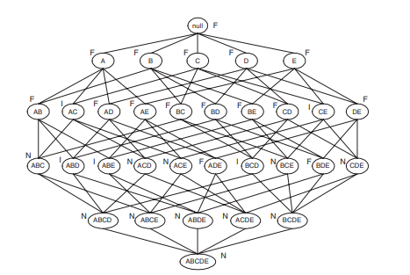
Answer 3
b) Percentage of frequent itemsets = 16/32 = 50.0% (including the null set).
c) Pruning ratio is the ratio of N to the total number of itemsets. Since the count of N = 11, therefore pruning ratio is 11/32 = 34.4%.

Slide 76
Answer 4
Ans a)The leaf nodes visited are L1, L3, L5, L9, and L11.
b) The candidates contained in the transaction are {1, 4, 5}, {1, 5, 8}, and {4, 5, 8}.

Slide 77
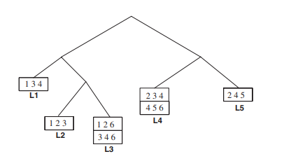
Answer 5

Slide 78
THANK YOU
Dr. N MEHALA
Department of Computer Science and Engineering
mehala@pes.edu

Slide 79
THANK YOU
Dr. N MEHALA
Department of Computer Science and Engineering
mehala@pes.edu

Slide 80
MACHINE INTELLIGENCE
Resources
http://www2.ift.ulaval.ca/~chaib/IFT-4102-7025/public_html/Fichiers/Machine_Learning_in_Action.pdf
http://wwwusers.cs.umn.edu/~kumar/dmbook/.
ftp://ftp.aw.com/cseng/authors/tan
http://web.ccsu.edu/datamining/resources.html

Slide 81
THANK YOU
Dr. N MEHALA
Department of Computer Science and Engineering
mehala@pes.edu

